Slide 1
Session: Prevention and Vector Control
Up to date on ITN distribution through ANC and MRC Zanzibar
Shara Hemed
ZAMEP

Slide 2
Presentation outline
Introduction
ANC distribution scheme
  ITNs issued through ANC in 2023
Results from Mini MRC 2023
Preparation for upcoming MRC 2024
  time line for MRC 2024
Implemented activities to support ANC distribution in 2022
Up to date on upcoming MRC
LLIN distribution operational challenges
LLIN priority areas for 2024
Budget for 2023 priority areas

Slide 3
Introduction
The Ministry of Health Zanzibar through ZAMEP is continuing to provide service of free ITNs distribution through:
  ANC distribution scheme
    Pregnant women during the 1st visit
    Children at nine months when attending HFs for MR1 vaccination
MRC after every 2.5yrs
The objective of the distribution
  to maximizing ITNs ownership and usage at household level
  ensure people are prevented from getting malaria transmission by proper use of ITNs
  throughout a year
Both distribution schemes are supported technically by USAID under TVCA project TZ

Slide 4
ANC distribution
A total 182 HFs are involving in ANC distribution scheme (Unguja109, Pemba 73)
The distribution trend is monitored by using
  The Chandarua Kliniki Dashboard
  Supervision visits are conducted based on dashboard information
    Conducted in quarterly basis
    Areas that are identified with challenges are given priority for supervision
This is an integration distribution approach that involving
  HMIS of MOH - data mgt
  ZAMEP - overall coordinator
  TVCA - provide TA
  GHSC - monitoring distribution trend
  LMU of MOH - monitoring distribution trend
  HFs - net issuing to customers

Slide 5
ANC ITNs issued Jan – Dec 2023 vs target groups
Target groups | Target | ITNs issued | Percentage
Pregnant women | 70,520 | 68132 | 97
MR1 | 70,520 | 65194 | 92
Total | 141,040 | 133,326 | 95
Source: DHIS2 - HMIS Zanzibar

Slide 6
ANC ITNs issued Jan – Dec 2023 vs contact and doses
ANC ITNs distribution scheme
Districts | ANC |  |  | MR 1
 | 1st contact | LLINs | % | Dose | LLINs | %
Chakechake | 5,083 | 5,376 | 105.8 | 6,204 | 6,204 | 100.0
Micheweni | 5,308 | 4,957 | 93.4 | 5,511 | 5,511 | 100.0
Mkoani | 4,441 | 4,441 | 100.0 | 4,673 | 4,581 | 98.0
Wete | 5,574 | 5,568 | 99.9 | 6,341 | 6,341 | 100.0
Kaskazini A | 6,254 | 6,250 | 99.9 | 5,892 | 5,777 | 98.0
Kaskazini B | 3,427 | 3,388 | 98.9 | 3,607 | 3,365 | 93.3
Kati | 5,818 | 5,062 | 87.0 | 5,032 | 4,660 | 92.6
Kusini | 2,258 | 2,336 | 103.5 | 2,214 | 2,113 | 95.4
Magharibi A | 9,402 | 8,622 | 91.7 | 10,637 | 8,670 | 81.5
Magharibi B | 10,388 | 9,697 | 93.3 | 11,172 | 8,912 | 79.8
Mjini | 12,286 | 12,435 | 101.2 | 10,023 | 9,060 | 90.4
Total | 70,239 | 68,132 | 97.0 | 71,306 | 65,194 | 91.4
Source: DHIS2 - HMIS Zanzibar

Slide 7


Results from MRC 2023
In 2023 a total of 75 Shehia from five districts have been given ITNs through min mass campaign
The electronic registration was used at first for MRC Zanzibar
Historical the 53 shehia were given ITNs in 2020
  Due to identified to report abnormal number of cases by that time
  Additional 22 shehia were given ITNs to reduce transmission
Therefore, the 75 shehia will not be considered for 2024 MRC
District | Shehia covered | Target /registration | No. of ITNs issued | Proportion- attained
Urban | 32 | 76,286 | 67,662 | 89
West ‘B’ | 11 | 92,523 | 82,932 | 90
West ‘A’ | 10 | 77,673 | 71,089 | 92
South | 21 | 33,008 | 29,819 | 90
Central | 1 | 679 | 653 | 96
Total | 75 | 280,169 | 252,155 | 91

Slide 8
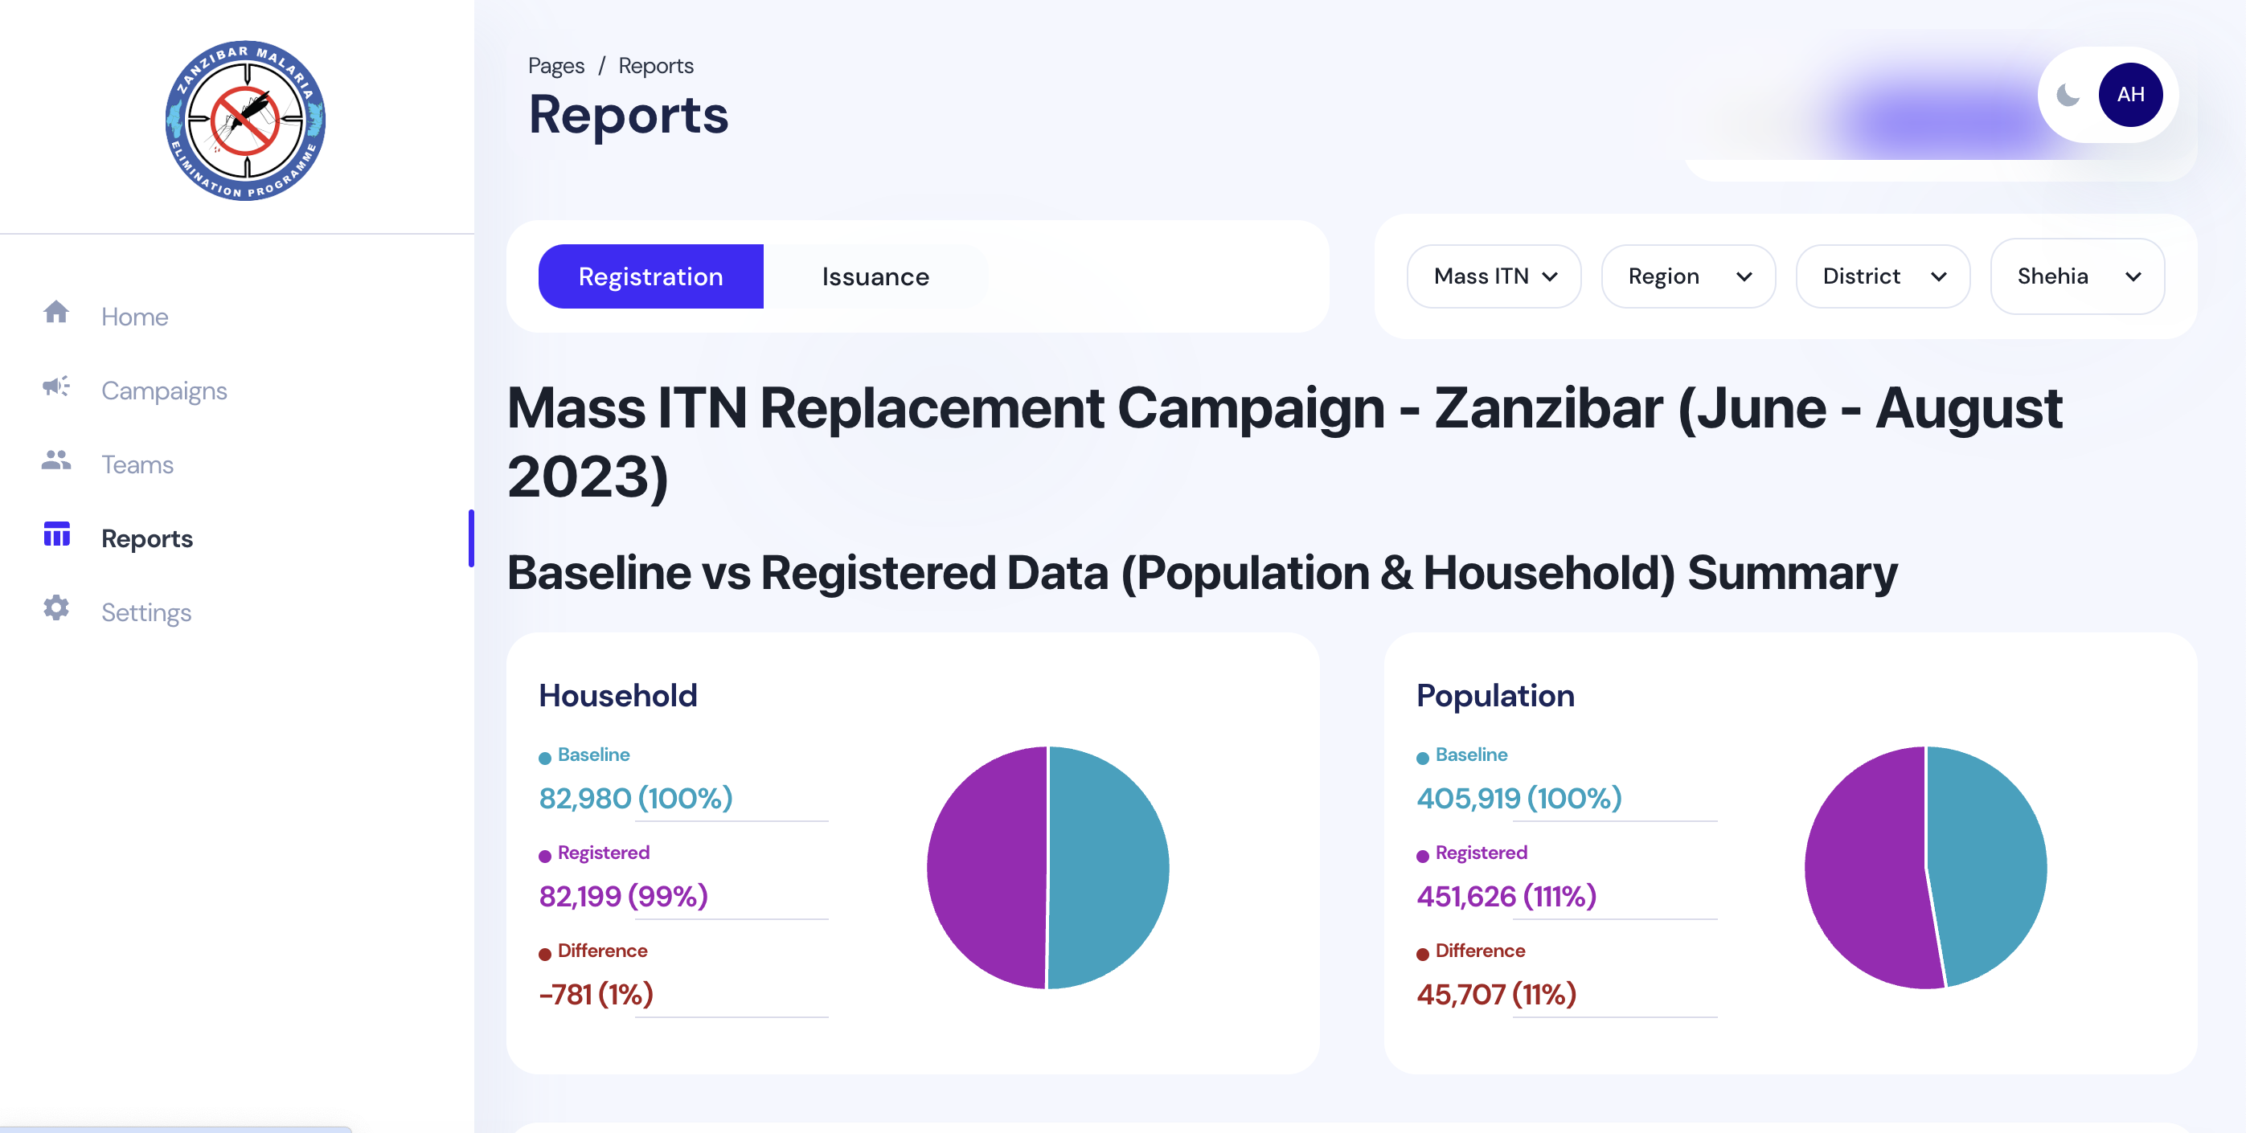
Preparation for MRC 2024
The MRC for 2024 is planned to take place on 27th April
MRC launching will take place on 25th April during the CWMD
A total of 313 shehia (129-Pemba) will be benefited from the campaign
The electronic registration system shall continue to be used for entire registration process
  Quantification on the number of ITNs
  The system also provide ID number for HH member

Slide 9
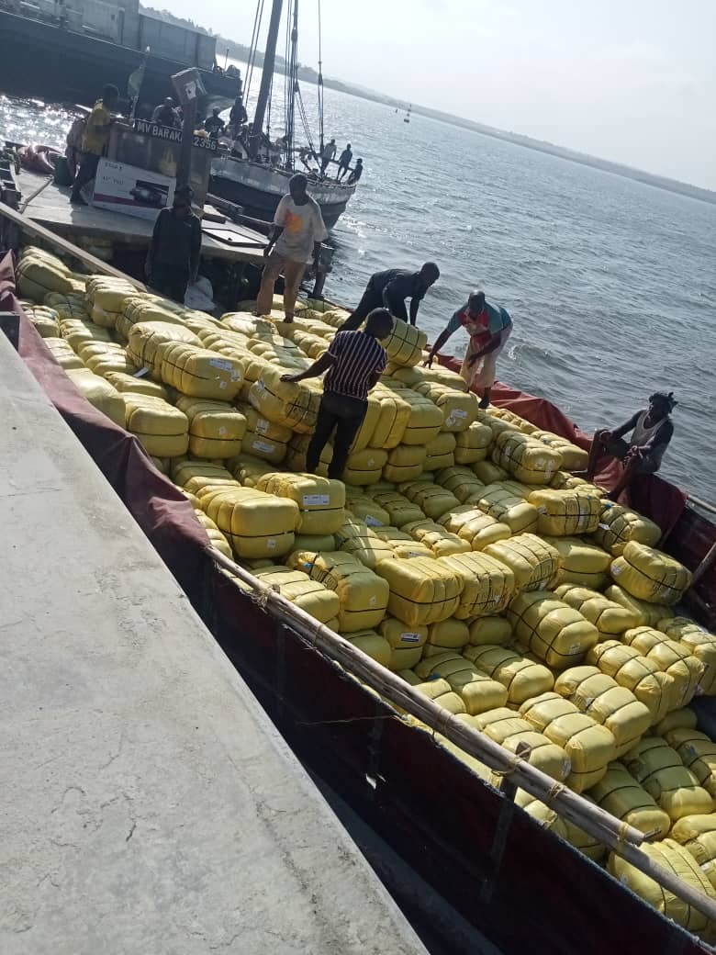
Preparation for MRC 2024 cont…
So far the MRC task force established and continuing to meet for planning periodically
The distribution plan has been developed and started to be used for direction
A total of 782,000LLINs is estimated to be distributed Unguja and Pemba at the end of campaign
Per GHSC the ITNs consignment shall arrive Zanzibar on the last week of March 2024 for the campaign

Slide 10
MRC Timelines Summary- 2024
ACTIVITY | No. OF DAYS | DATES
Advocacy meeting – National level | 1 | 14th March 2024
Advocacy Meetings – District & Shehia Level | 7 | 22nd - 28th March 2024
National Level Trainings | 2 | 19th - 20th March 2024
District level Training | 7 | 2nd – 9th April 2024
Start SBC Activities | N/A | 6th April 2024
HouseHold Registration | 10 | 12th – 16th April 2024
Review & Validation of Household data & Share final data | 7 | 17th – 23rd April 2024
Launch Event | 1 | 25th April 2024
Distribution & Net Issuing to the community | 7 | 27th April – 4th May
End of SBC Activities | N/A | 10th May 2024

Slide 11
MRC Timelines Summary
ACTIVITY | NUMBER OF DAYS | DATES
Advocacy meeting – National level | 1 | 14th March 2024
Advocacy Meetings – District & Shehia Level | 7 | 22nd - 28th March 2024
National Level Trainings | 2 | 19th - 20th March 2024
District level Training | 7 | 2nd – 9th April 2024
Start SBC Activities | N/A | 6th April 2024
HouseHold Registration | 10 | 12th – 16th April 2024
Review & Validation of Household data & Share final data | 7 | 17th – 23rd April 2024
Launch Event | 1 | 25th April 2024
Distribution & Net Issuing to the community | 7 | 27th April – 4th May
End of SBC Activities | N/A | 10th May 2024

Slide 12
Capacity building to New ANC workers
A total of 250 new health workers have been trained on the distribution scheme
  Requesting net through R&R
  Filling net registration ledger
  Proper storage of nets at HFs level
  Importance of redistribution in case of serious shortage of nets
Feedback meeting with integrated unit
  This was quarterly basis meeting invite a total 25participants in each quarter
  Discussed operational challenges and find out remedial measures to improve the ANC distribution

Slide 13
Monitoring and supervision of LLIN distribution
Monitoring & supervision was conducted to evaluate the progress of the distribution at HFs
  identified operational challenges, and take action to improve implementation quality
Chandarua Kliniki dashboard was used to monitor and determine poor performing districts and health facilities
Supervision visits were conducted to districts and health facilities each quarter to identified ITNs distribution operational challenges
M& S visits were involved ZAMEP, CMS, HMIS, LMU, DHMTs, and TVCA
TVCA tprovided technical support for the entire ANC distribution scheme and MRC
Pls Weka picha ya dash board hap

Slide 14
Workout comments from monitoring supervisor's
Data quality to be strengthen including provision of training to health workers and improve data collection tools
Strengthen Monitoring and Supervision to all health facilities identified with challenges
The plan for ITNs re-distribution data to be shared to all stakeholders before the distribution started by Simba logistics or Central Medical Store, this will avoid duplicate for the information collected at ANC level
The ITNs re-distribution should be conducted timely to all HFs identified with overstock of nets
Mentorship to new ANC workers should be highly considered, this will improve distribution scheme to the most of HFs identified with the shortage of untrained HWs

Slide 15
Priority areas for 2025
Procure New (dual) generation nets for ANC and MRC distribution
Distribution LLINs to all health facilities as needed
Orient all new health workers on ANC distribution schemev
Support to Print some revised ANC HMIS Registers
Monitor and supervise LLIN distribution activities
Conduct feedback meetings with other integration units (CMS, LMU, HMIS) and DHMTs
Intensify SBCC campaign for increasing LLIN use country wide

Slide 16
Budget
9 | Activity | Usd | Remarks
1. | Procure of PBO or new generation nets, 144,607pcs for ANC | 000,000 LLINs | ZAMEP will receive nets from USAID
2 | Procurement of PBO or new generation nets, 781,991 pcs for MRC 2024 in 335 Shehia | 000,000 LLINs | ZAMEP will receive nets from USAID
3. | Operational cost for MRC in 335 Shehia | 150,000
4 | Nets re-distribution to the Health facilities | 27,675
5. | Orientation training to new ANC workers | 47,675
6 | Quarterly monitoring and supervision of distribution at ANC | 55,342
7 | Quarterly advocacy and feedback meetings with integration units (CMS,LMU, HMIS,ZAMEP) | 43,348
8 | Quarterly feedback meeting with head of ANC and DHMTS | 46,734
9 | Procure 4 motorcycles (Trailers 110) to support quick monitoring of ANC |  | ZAMEP to receive motorcycles
 | Total | 370,774

Slide 17
THANK YOU VERY MUCH

